Slide 1
BESS – The Business, Economics and Social Studies Programme (TR081)
School of Business, School of Social Sciences and Philosophy
Professor Sarah Browne
Professor Michael Wycherley
Academic Co-Directors of BESS
Saturday 23 March 2024
Trinity College Dublin, The University of Dublin

Slide 2
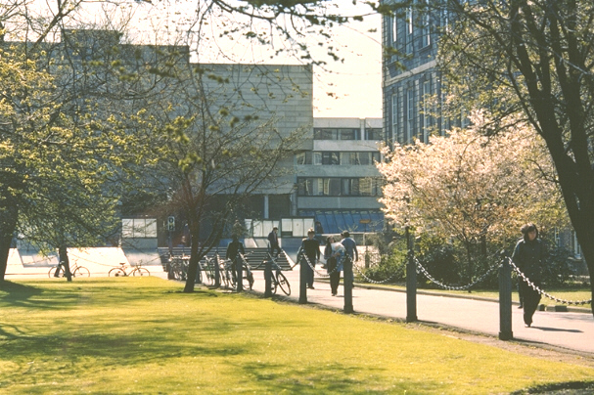
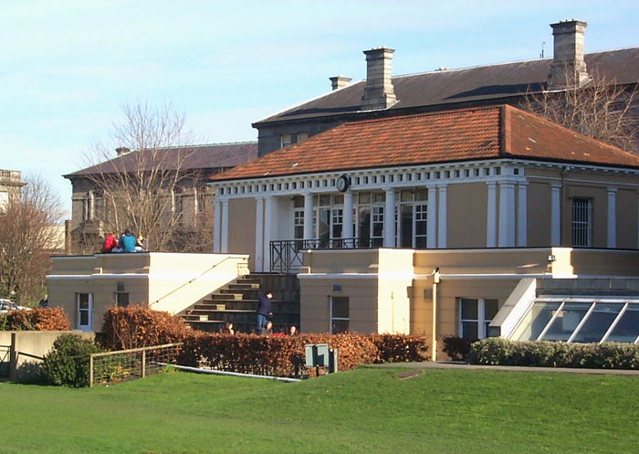
Trinity College… Founded in 1592
A University of Global Consequence
Notes:
The leading Irish research university
Global recognition
Ranked 1st in Ireland and 101th in the World
A community of Scholars
Nobel prize winners
Beckett, Shaw, Walton
For the purpose of compiling the rankings, 5,100 academics from around the world were surveyed concerning the research quality of the university and their views accounted for 40% of the score. In addition, 1,480 international employers in a recruiter review were surveyed concerning their views on graduate employability which accounted for 10%. The other half of the marks was made up of teaching quality which was measured by staff: student ratio (20%), a further 20% was allocated to research quality which was gauged by the university’s citations of major papers. The international outlook was also measured by international faculty staff (5%) and international students (5%). Trinity College scored highly in all of these categories.

Slide 3
What is BESS?
Business
Economics
Political Science
Sociology
Notes:
BESS is the only university degree in Ireland where students can combine the study of business, economics, political science and sociology.
It is a uniquely flexible programme offering a broad-based education in business, economics, political science and sociology in the first year. After this students can adjust their options to reflect their academic strengths, interests and emerging career aspirations. This unique aspect of the programme gives students the time to engage with all four areas and then the opportunity to specialise to a high level in either one (single honor) or two (joint honors) chosen subjects or disciplines.

Slide 4
Business
Gain an understanding of the role of management and organisation in society and knowledge of:
marketing, finance, accounting, entrepreneurship, strategy, human resources, innovation, operations, information systems and many more.
Notes:
Business
Trinity Business School is a globally-renowned, triple-accredited business school. In today’s rapidly changing world, we strive to embed environmental, social, and governance solutions into our curriculum to inspire our students and future business leaders to tackle urgent societal issues. We are committed to our strategy of “Transforming Business for Good ” by embodying a value system of ‘putting in more than we take out’ and being a force for good in business and society.
You will gain an understanding of the role of management and organisation in society and knowledge of: marketing & consumer behaviour, finance, accounting, strategy, human resource management, innovation & entrepreneurship, operations & supply chain management, business ethics, and many more.

Slide 5
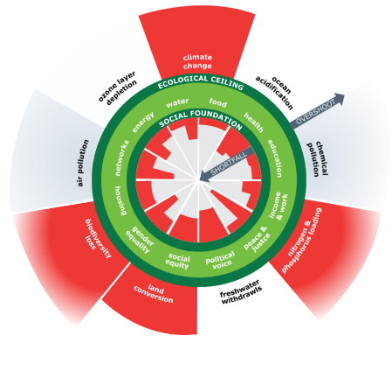
Economics
Develops the concepts and tools to understand:
How to limit / prevent unemployment
How to regulate financial markets
How to control the market power of large firms
How best to address climate change
How to help poorer countries grow and develop
Notes:
Economics
Explores and analyses the use of resources, growth of production, distribution, and consumption of goods and services, and other complex issues of vital concern to society and global economies- you will learn about key concepts of scarcity, supply and demand, costs and benefits, incentives, and power- which can help explain many decisions that individuals, and governments & policy makers make.

Slide 6
Political Science
The scientific study of politics, the exercise of power and the workings of democratic political institutions
Students will learn about
How democracy works
How people vote
How political parties compete
How European integration works
The values behind political ideologies
Notes:
Political Science
This branch of the programme involves the scientific study of politics, the exercise of power and the workings of democratic political institutions
Politics affects us all in our daily lives. Should government tax the rich for greater equality? Should the amount of money the EU spends on agriculture be cut? Questions such as these, along with analysis of political systems and how democracy works, are at the heart of the study of politics.
The values behind political ideologies- liberalism, conservatism, socialism

Slide 7
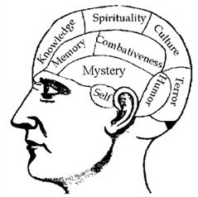
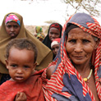
Sociology
Studies social change and social consequences of human behaviour. Understand phenomena such as:
Social change and how it affects your own life and that of others
Shared practices of behaviour
Social movements like fair trade or feminism
Inequality long lines of social class, gender, race and ethnicity
The nature and meaning of work
Notes:
Sociology
In simple terms Sociology is the scientific study of society. It looks at the development, structure, and functioning of human society and the study of social problems within that society.
It also explores patterns of social relationships, how social change comes about, and the consequences of human behaviour. When you study sociology, you will get the opportunity to analyse people and societies, exploring areas as diverse as migration, race and gender, conflict studies, digitalisation, identities and employment studies.

Slide 8
What does BESS offer?
1 entry pathway
4 disciplines
10 different degree options
22 exit routes
Honors bachelor degree in one of the flagship programmes at TCD
A unique university degree
Flexible pathway programme with multiple degree options across these four subjects

Slide 9
BESS: 10 different degree combinations
Business
Economics
Political Science
Sociology
Business & Economics
Political Science & Sociology
Economics & Sociology
Business & Political Science
Sociology & Business
Economics & Political Science
Single Honors
Joint Honors/Major with Minor
Notes:
Explore the world of business and management
Study subjects including marketing, management, human resources, innovation, strategy, entrepreneurship, accountancy and many more.
Flexible programme with 10 different degree options across these four subjects

Slide 10
BESS: 22 Exit Routes
Major with Minor (12)
Joint Honors (6)
Single Honor (4)
Major/ Minor Degrees
Manjor Sociology / Minor Political Science
Major Business/ Minor Economics
Major Business/ Minor Political Science
Major Economics / Minor Business
Major Economics / Minor Political Science
Major Sociology / Minor Business
Major Economics / Minor Sociology
Major Political Science / Minor Economics
Major Political Science / Minor Business
Major Political Science/ Minor Sociology
Major Sociology/ Minor Economics
Major Business/ Minor Sociology
Single Honor Degrees
Economics
Political Science
Business
Sociology
Joint Honor Degrees
Business and Economics
Business and Political Science
Sociology and Business
Economics and Political Science
Economics and Sociology
Political Science and Sociology
Notes:
22 exit routes

Slide 11
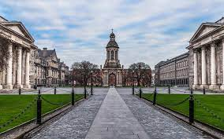
What will I study? Junior Fresh – 1st Year (overview)
Start with a grounding in all four subjects
Fundamentals of Management and Organisation
Introduction to Economics
Introduction to Political Science
Introduction to Sociology
Mathematics and Statistics
Another module of your choice (Language, Law or Social Policy)

Slide 12
What will I study? Senior Fresh – 2nd Year
Continue with those subjects that interest you
Ensures you have the fundamental skills in the one or two subjects you choose
Option to continue with language module
Or something totally different through Trinity Electives
Foundation Scholarship a historic & prestigious award with material benefits as well
Notes:
\

Slide 13
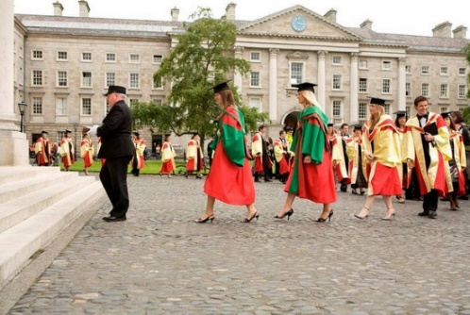
What will I study? Junior & Senior Sophister – 3rd & 4th Year
In the last two years choose the modules that interest you
Specialise in one (Single honor) or two (Joint honors/Major with Minor) subjects
An opportunity to study abroad in third year
Capstone project: Undertake a large independent project in the final year using the skills & knowledge you have gained
Careers and continuing education information sessions provided
Notes:
Ordinary bachelor’s (Level 7, National Framework of Qualifications)
and honor bachelor’s degree ((Level 8, National Framework of Qualifications)

Slide 14
BESS Study Abroad Programme
Languages options (French, German, Polish, Russian and Spanish) are integrated into the BESS programme
Students can choose to study abroad during their third year:
In Europe (e.g., Germany, France, Spain, the Netherlands)
Around the globe (Australia, USA, Canada, Asia)
Notes:
First and second year B.E.S.S. students have the option to study Irish, French, German, Spanish, Russian or Polish. Students also have the opportunity to study abroad in their third year at leading universities in countries such as France, Germany, Italy, Netherlands, Austria, Belgium or Spain, as well as English-speaking international exchange programmes to prestigious universities in Europe, North America, Australia and Asia (China, Hong Kong and Japan). Some of the more popular universities are Uppsala University, Sweden; Emory University, Georgia, Senshu University, Japan; IEP – Institut d’Études Politiques de Paris, France; QUT Queensland University of Technology, Brisbane, Australia and the University of Copenhagen, Denmark.

Slide 15
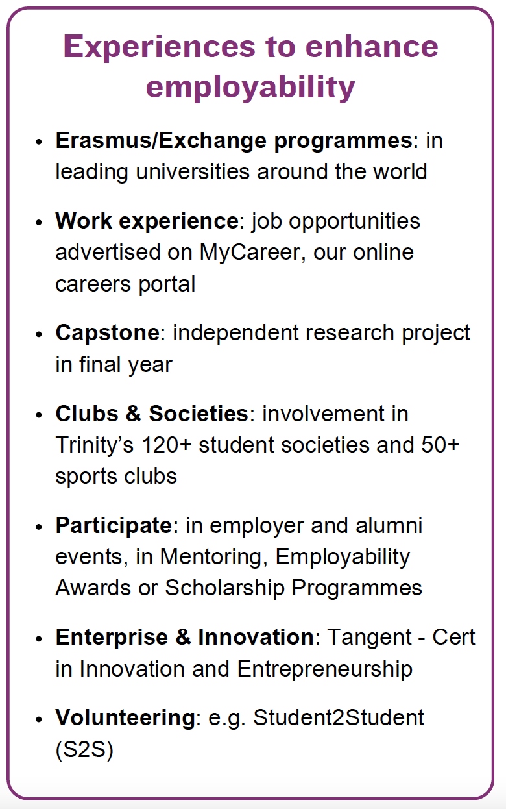
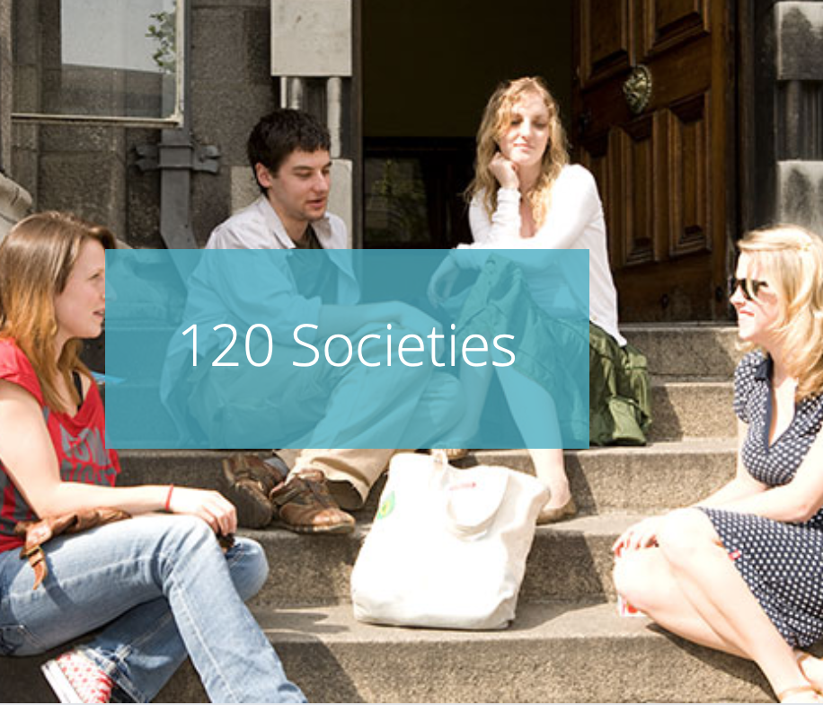
The Trinity Experience
SOCIETIES:
“From arts, culture, politics and debating to gaming, advocacy and music, you're sure to find your niche.”
SPORTS
“Get fit, stay active, and meet people outside the classroom!”
STUDY ABROAD:
”Hong Kong is a truly incredible place and is nowhere like I’ve ever been before.”
www.tcd.ie/students/clubs-societies
www.tcd.ie/Sport/student-sport/clubs/
www.tcd.ie/study/study-abroad
Notes:
Many societies and sport clubs organised by and for students
120 societies
The Hist
The Phil
Politics society
Sociology society
Trinity Entrepreneurial society
DUBES0 Dublin university business and economics society
SMF
TEF trinity economic forum
Foresight: Fostering strong relationships between TCD student and leading members of the Irish business community
Trinity business school forum- massive networking event
Enterprise: supports start ups
Upstart: entrepreneurs
Study abroad: Trinity has collaborations with some of the world's leading universities. For Trinity students, this means access to a network of more than 250 exchange opportunities across the globe.
Sports clubs: Trinity has 49 sports clubs, ranging from team sports,adventure sports, water sports to martial arts
An average of 6,000 students join one or more clubs & societies each year there is something for everyone

Slide 16
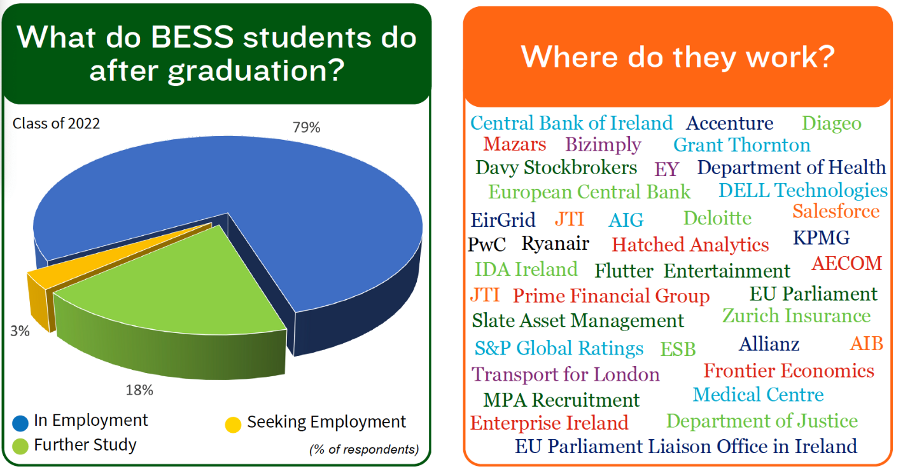
Your Future: Employability of BESS graduates
Class of 2022:
Notes:
Y our From a career perspective B.E.S.S. is an extremely flexible and practical degree programme.
Graduates are highly sought after by employers
And have gone on to successful and rewarding careers in varied roles around the globe in a range of fields, such as in finance and banking, politics, research, management consulting, teaching, public service, journalism, within both national and international organisations within the profit, not for profit and public sector.
The following are just a few examples of the organisations that have recruited B.E.S.S. graduates

Slide 17
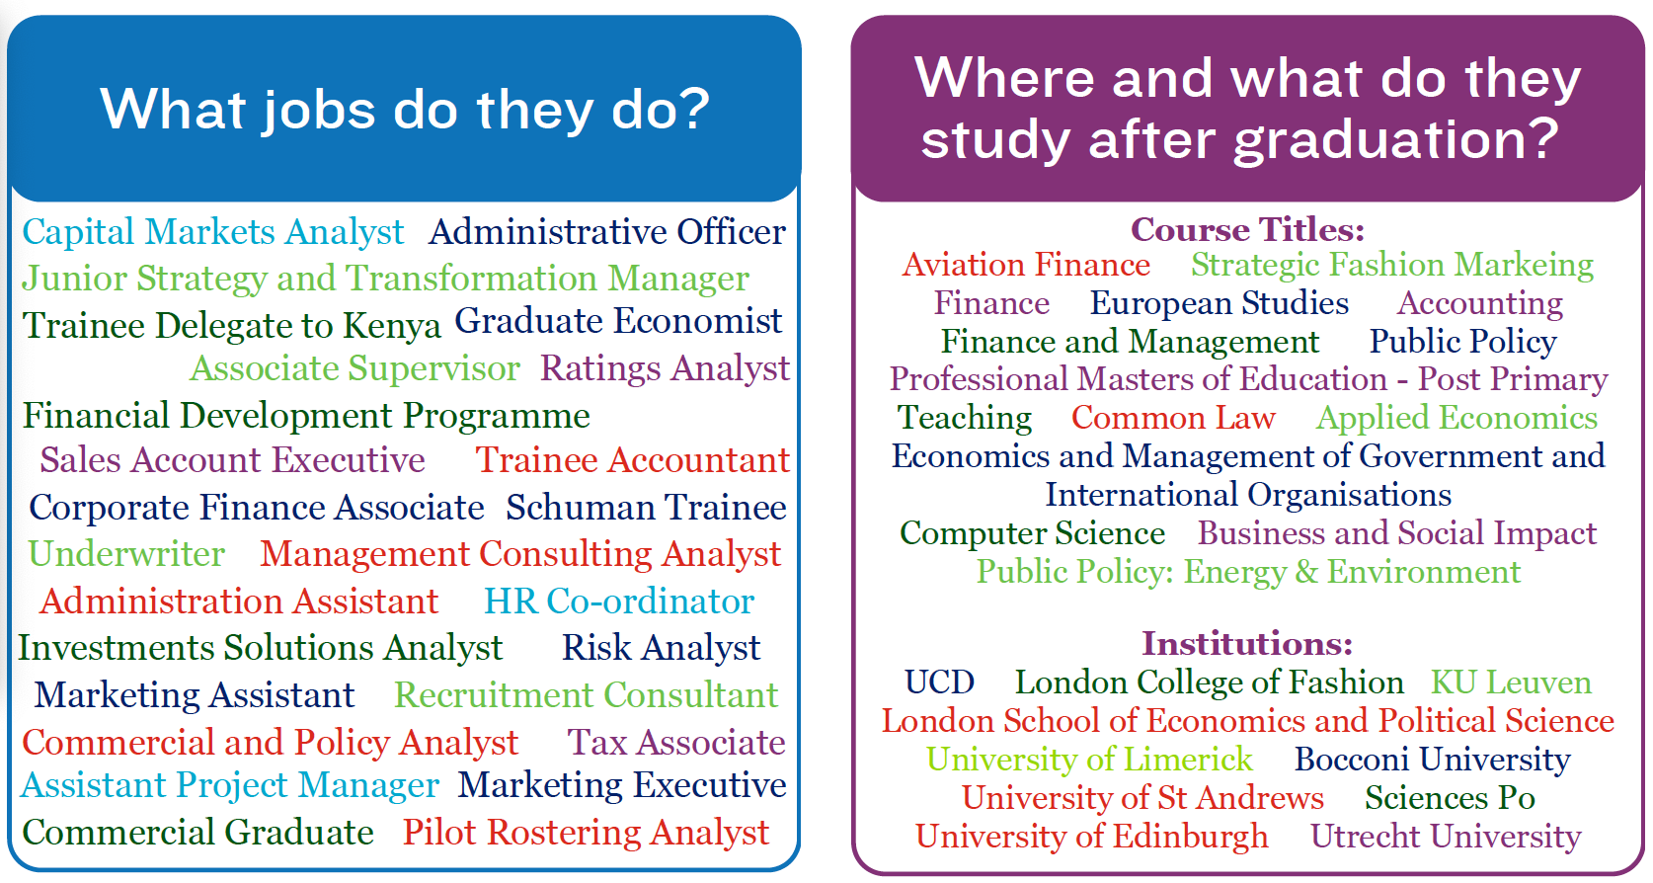
Your future: Employability of BESS graduates (contd.)

Slide 18
Why choose BESS? Summing up
Study at Ireland’s No.1 ranked University
Explore and critique the world around us from a variety of perspectives
Combines flexibility, breadth and depth
Student centred programme
Exceptional calibre of students
Strong reputation & highly sought after graduates

Slide 19
Applying for BESS- Central Applications Office (CAO)
https://www.tcd.ie/courses/undergraduate/courses/business-economics-and-social-studies/
2018 511*
2019 518*
2020 543*
2021 577
2022 567*
2023 554*
Minimum CAO Points 2018 - 2023
CAO Code: TR081
Number of places: 236
* Not all these points were offered places
International students please see:
https://www.tcd.ie/study/international/
Notes:
( (caThe task of processing applications to first year undergraduate courses in HEI in the Republic of Ireland is delegated to Central Applications Office (CAO)
The participating institutions retain the function of making decisions on admissions.
CAO is required to deal with applications in an efficient and fair manner.
CAO is a not-for-profit company registered in Ireland.
Points Required for Entry
BESS Quota

Slide 20
Other programmes at TCD with similar subjects
PPES: Philosophy, Political Science, Economics & Sociology
Global Business
Trinity Joint Honors:
Business/Economics/Politics/Sociology and one other subject
Allows different combinations but with only two subjects from the start

Slide 21
We hope you enjoyed this presentation & thank you for your time To find out more about BESS:
Visit our website and FAQ page at: www.tcd.ie/ssp/undergraduate/bess/
Send us an email bess@tcd.ie
Come say hello at the BESS programme stand (Arts block)/ TBS stand
Professor Sarah Browne
Professor Michael Wycherley
(Academic Co-Directors of BESS)

Slide 22
Thank You Go raibh maith agat
Trinity College Dublin, The University of Dublin

